Slide 1
CSE5095-002: Topics in Software Defined Networking
Lecture 4
Minmei Wang
Computer Science and Engineering

Slide 2
Efficient software and testbed for network experiments

Slide 3
Outline
Wireshark
NS-3
DPDK
CloudLab
Open vSwitch
Mininet

Slide 4
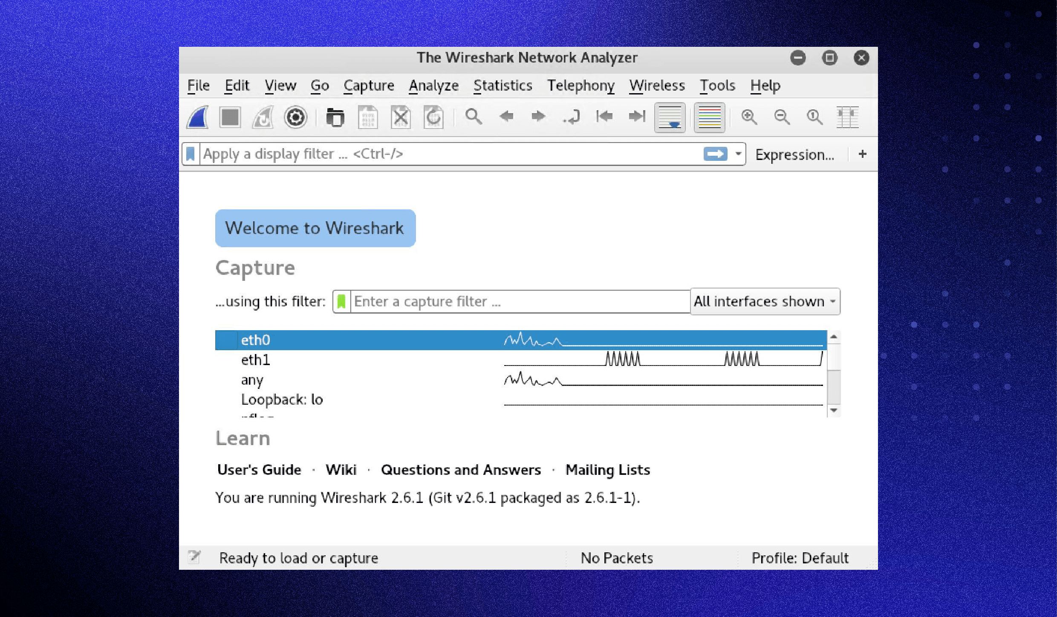
Wireshark
A packet sniffer and analysis tool
Capture packets

Slide 5
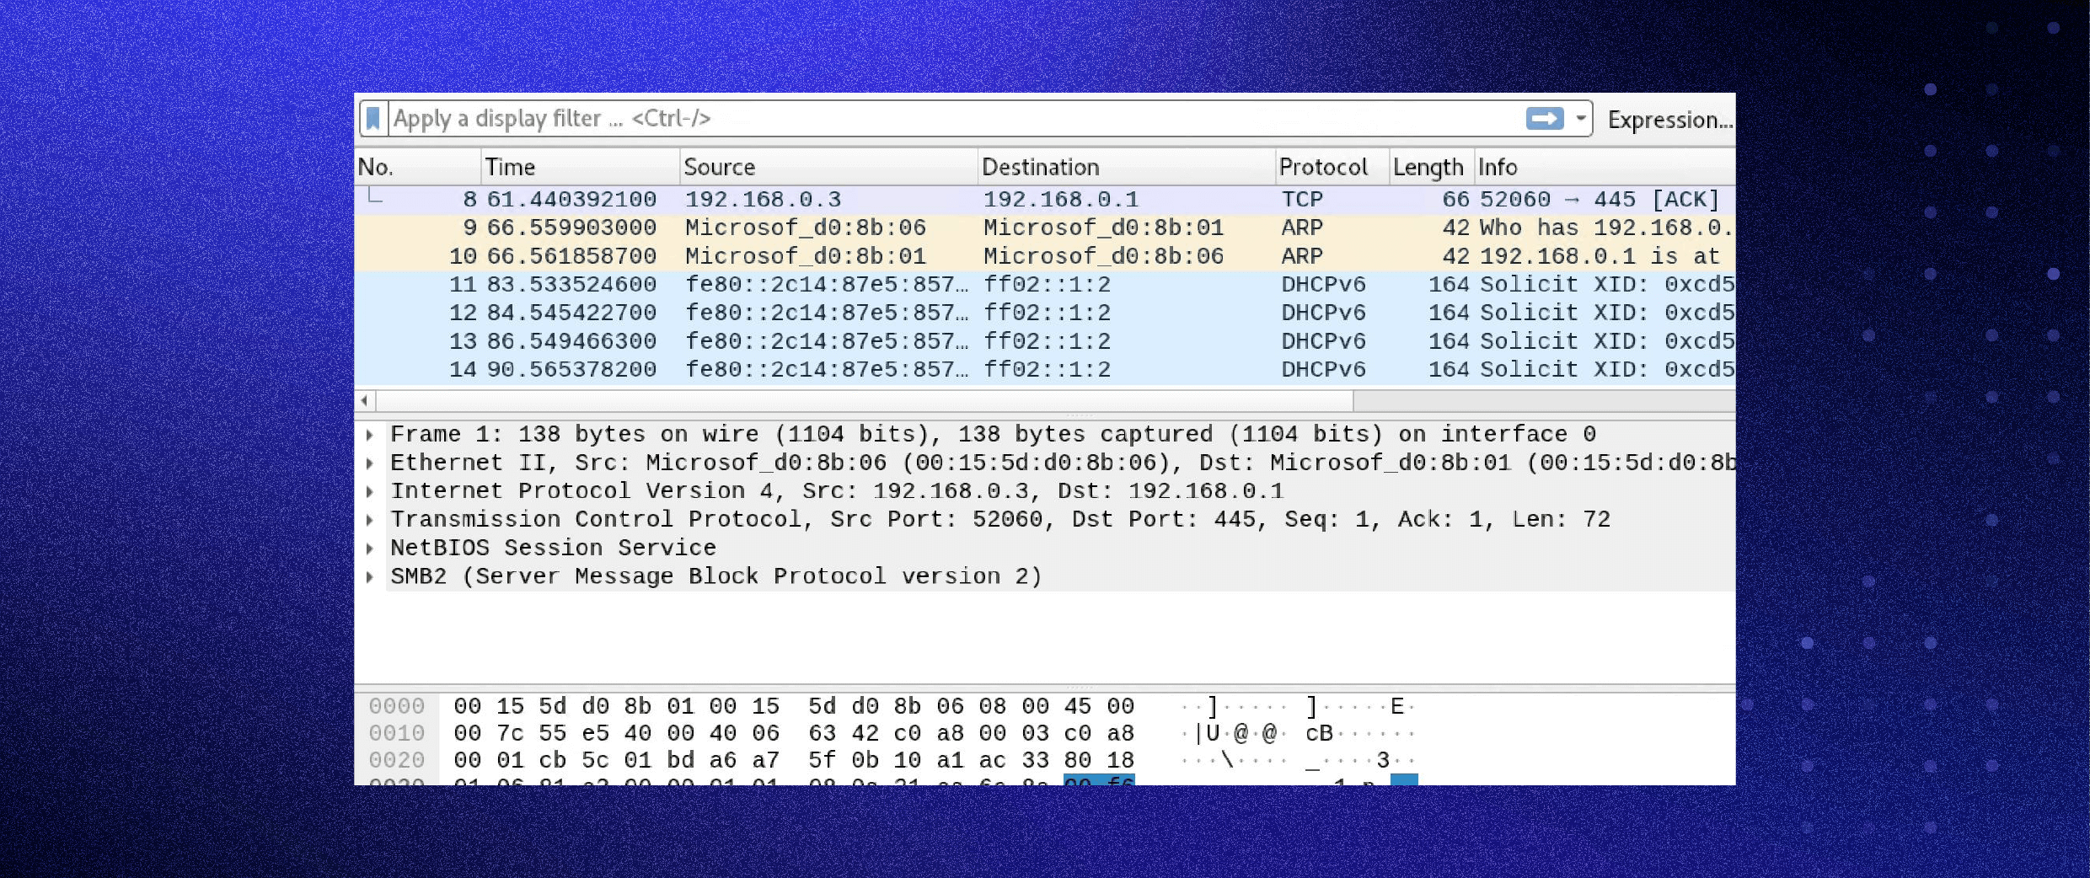
Wireshark
Analyze packets

Slide 6
Outline
Wireshark
ns-3
Open vSwitch
Mininet
DPDK
CloudLab

Slide 7
What is ns-3
Network Simulator Version 3
Software simulated models
Discrete-event simulator
Discrete-Event Simulation
Written in C++/Python binding
Focus on packet level
Wired/Wireless

Slide 8
Why ns-3?
Simulation V.S. Testbed
Reproducibility
Ease of deployment
Investigate non-existed systems
Scalability
ns-3 V.S. other simulation tools
Community-oriented
Free and open-source
Ease and debugging

Slide 9
Installation
Instructions
https://www.nsnam.org/wiki/Installation
Supported systems
Linux
MacOS
FreeBSD
Windows (use virtual machine)

Slide 10
Development environment
IDE
Eclipse
QT Creator
NetBeans
Text editor + command line

Slide 11
The basic ns-3 Data Flow Model
Application
Application
Application
Application
Sockets-like
API
Protocol
stack
Protocol
stack
Packet(s)‏
Node
Node
NetDevice
NetDevice
NetDevice
Channel
NetDevice
Channel

Slide 12
NS-3 Models: Node & App
Nodes
End-Systems, Routers, Hubs, NATs
Applications
Bulk TCP transfer (sliding window)
Web browsing
Peer-to-peer file transfers
Video streaming
Chat

Slide 13
NS-3 Models: Protocol Stack
TCP-UDP-IPV4-IPV6
Routing Protocols
BGP – OSPF – EIGRP – OLSR – DSR – AODV
Multicast Protocols
PIM-SM/DM - DVMRP

Slide 14
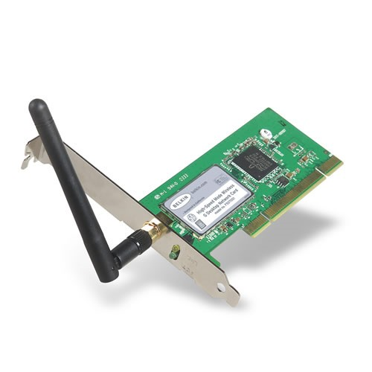
NS-3 Models: Net Device & Channel
Net Devices & Channels bound
WifiChannel
WifiNetDevice

Slide 15
NS-3 Models: Net Device & Channel
Network Interfaces
Wired/Wireless
Layer 2 protocols 802.3, 802.11
Channel
Ethernet (10/100/1000Mb)
Point-to-Point
Wireless
Mobility Models
Random Walk – move with a speed and direction chosen at random
Swarming

Slide 16
Useful Resources
ns-3 Wiki Page
https://www.nsnam.org/wiki/Main_Page
ns-3 Tutorial
https://www.nsnam.org/docs/tutorial/html/
ns-3 API Document
https://www.nsnam.org/docs/release/3.17/doxygen/index.html

Slide 17
Outline
Wireshark
NS-3
DPDK
CloudLab
Open vSwitch
Mininet

Slide 18
DPDK
Data Plane Development Kit consists of libraries provided by Intel to accelerate packet processing workloads running on a variety of CPU architectures
Handle packets by bypassing kernel space

Slide 19
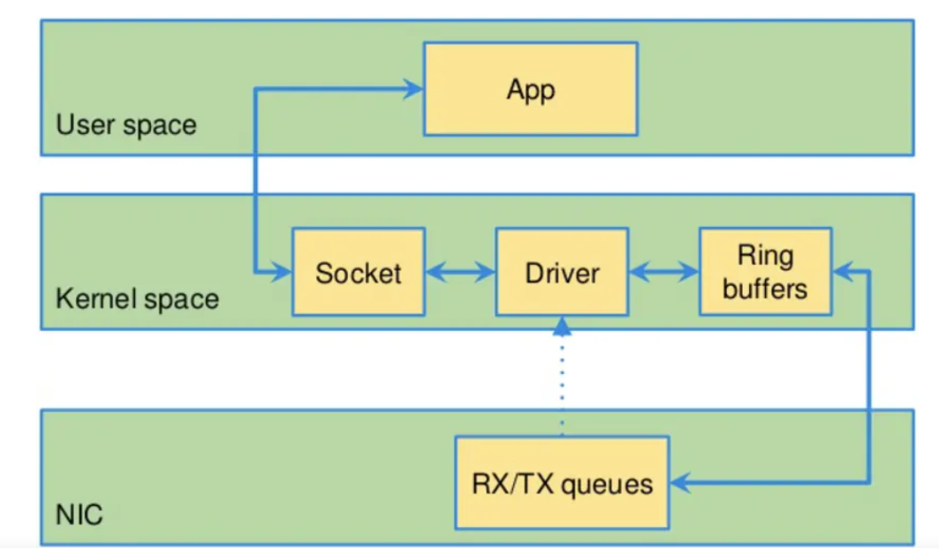
DPDK
DMA
interrupt
Traditional packet processing

Slide 20
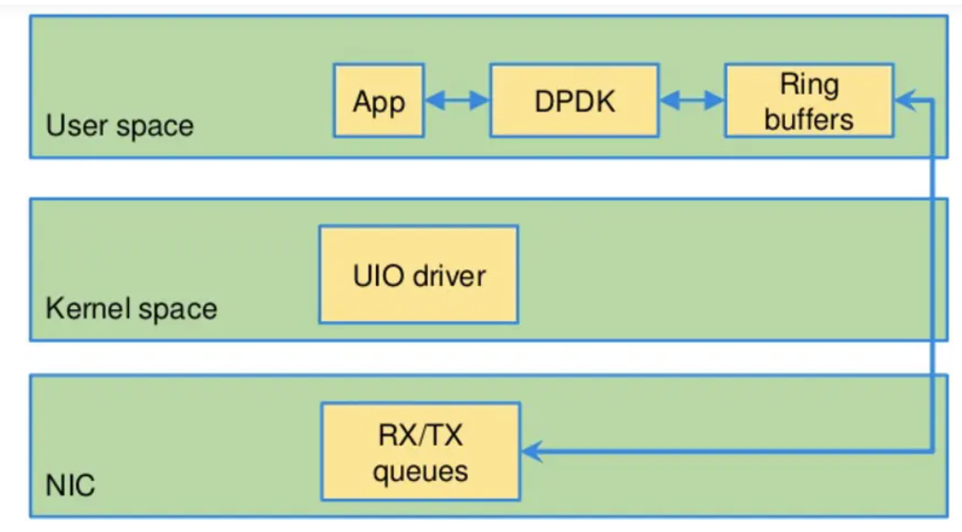
DPDK
Poll mode driver (PMD)
No interrupt
DPDK packet processing

Slide 21
DPDK
NICs support DPDK
Intel
e1000, ixgbe, i40e, ice, fm10k, ipn3ke, ifc, igc
NVDIA
mlx4, mlx5
More is listed on https://core.dpdk.org/supported/nics/

Slide 22
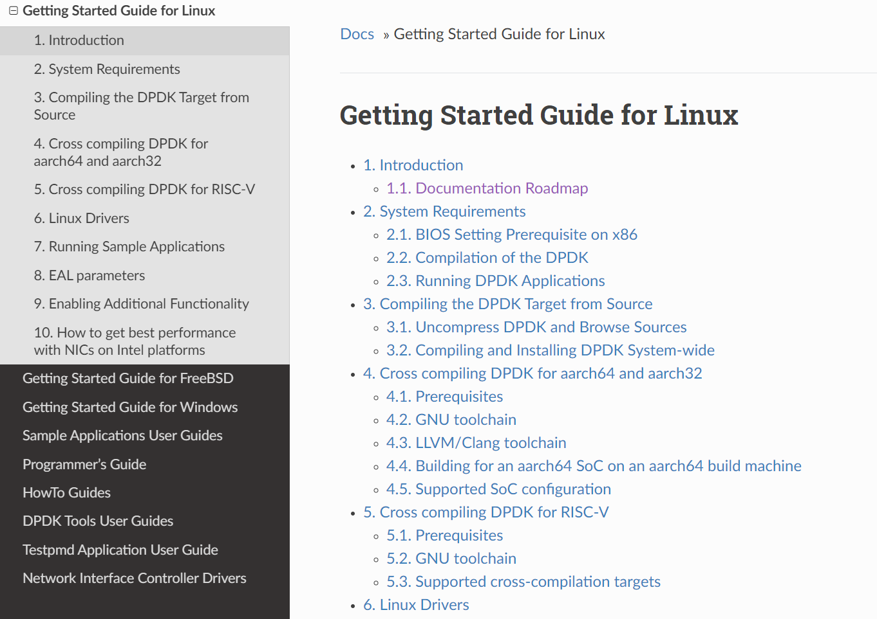
DPDK
Tutorials
https://doc.dpdk.org/guides/linux_gsg/index.html

Slide 23
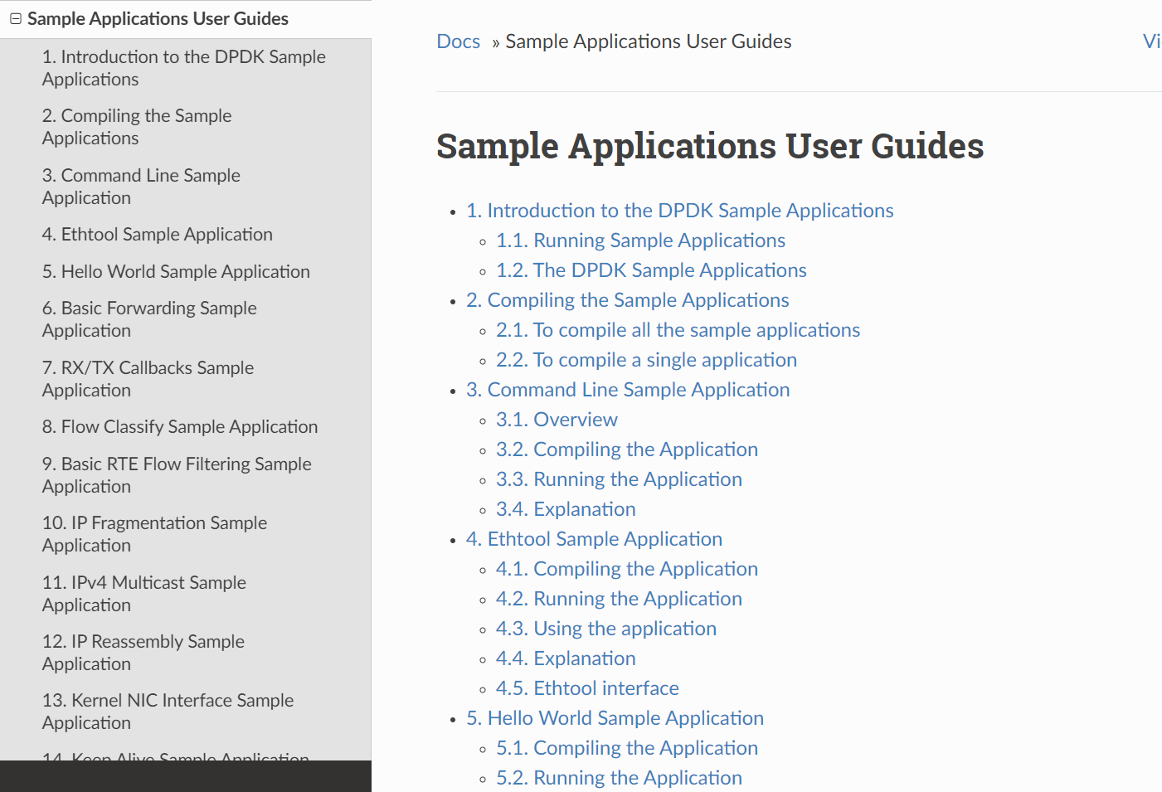
DPDK
Sample applications

Slide 24
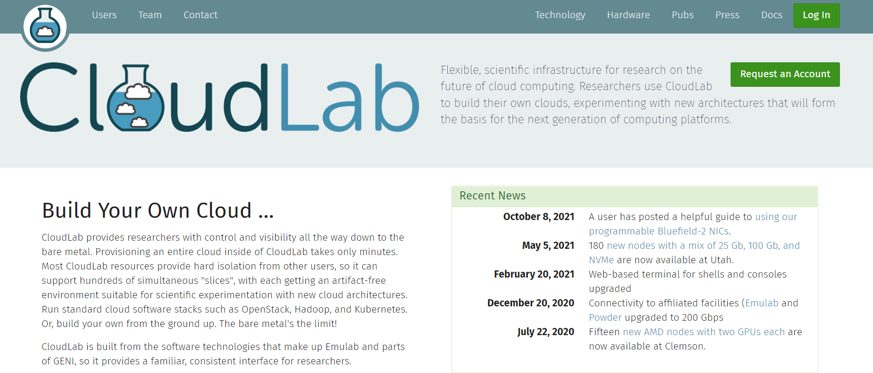
CloudLab
CloudLab is a testbed designed for researchers to do experiments with architectures.

Slide 25
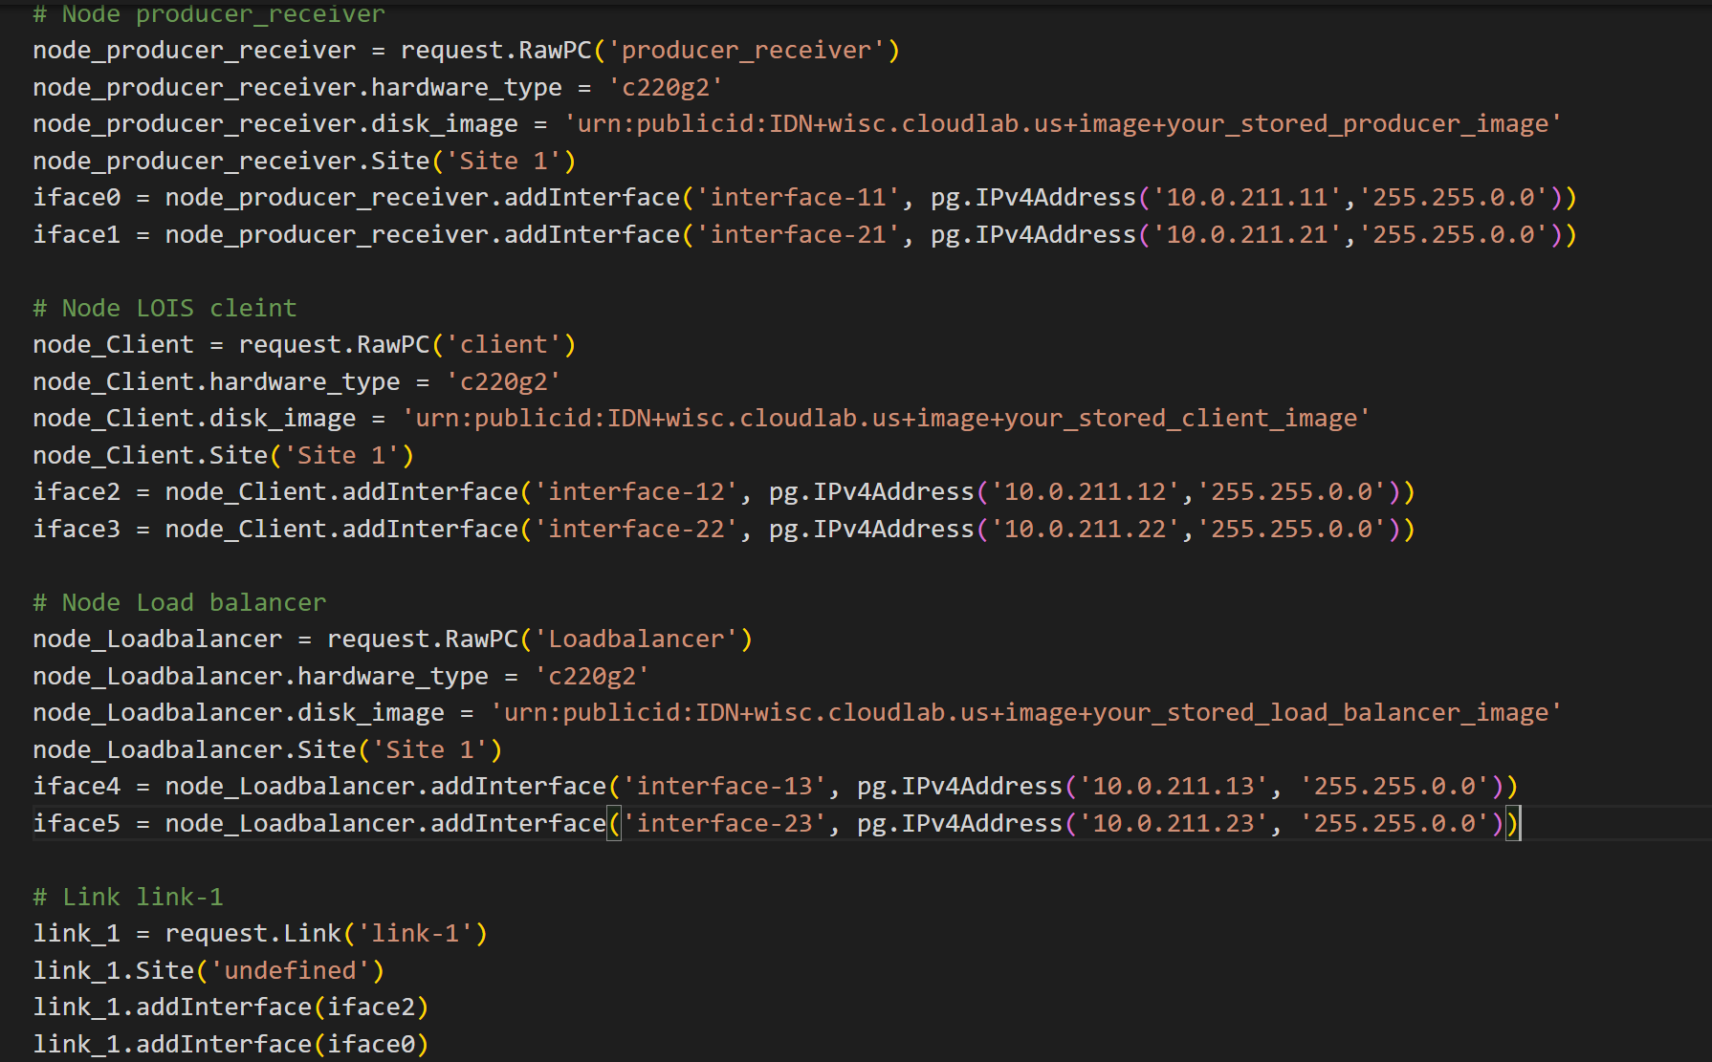
CloudLab
Build topology by a python script

Slide 26
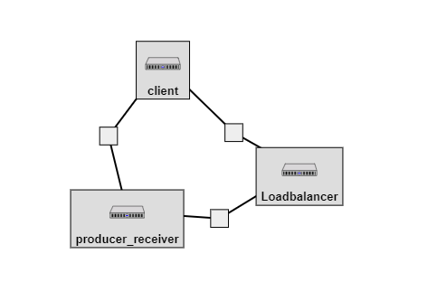
CloudLab
Topology viewer
Pktgen: a software-based traffic generator powered by DPDK
Link: https://pktgen-dpdk.readthedocs.io/en/latest/

Slide 27
Outline
Wireshark
NS-3
DPDK
CloudLab
Open vSwitch
Mininet

Slide 28
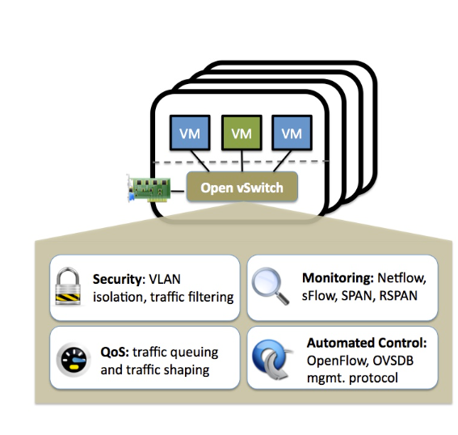
Open vSwitch (OVS)
Open vSwitch is a production quality, multilayer virtual switch
Link: https://www.openvswitch.org/

Slide 29
Open vSwitch (OVS) main components
ovs-vswitchd: a daemon that implements the switch, along with a companion Linux kernel module for flow-based switching.
ovsdb-server: a lightweight database server that ovs-vswitchd queries to obtain its configuration.
ovs-dpctl: a tool for configuring the switch kernel module.
ovs-vsctl: a utility for querying and updating the configuration of ovs-vswitchd.
ovs-appctl: a utility that sends commands to running Open vSwitch daemons.
…

Slide 30
Open vSwitch
Tutorials
https://docs.openvswitch.org/en/latest/tutorials/

Slide 31
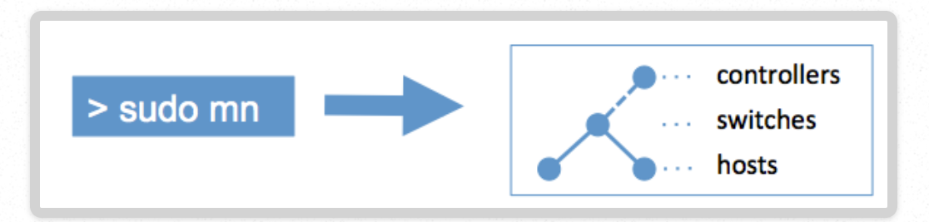
Mininet
Simulator
Create a realistic virtual network, running a real kernel, switch, and application code on a single machine

Slide 32
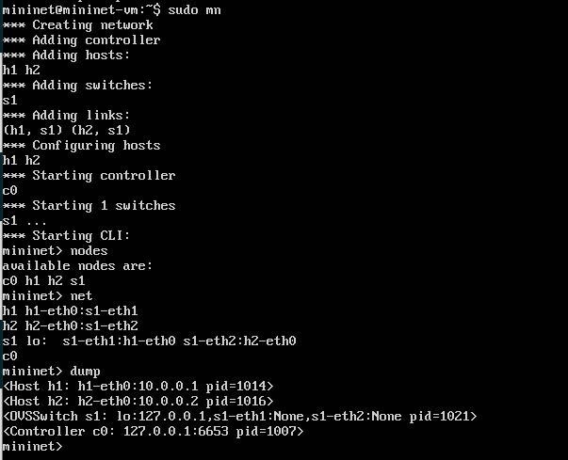
Mininet
sudo mn
-- switch
e.g., Open vSwitch (ovsk)
--topo
e.g., single, 3
--custom
Script to create topologies
--controller
Ryu
ONOS
OpenDaylight
…

Slide 33
Further readings
Walkthrough
http://mininet.org/walkthrough/#display-options
Mininet Python API
https://github.com/mininet/mininet/wiki/Introduction-to-Mininet
Practice examples
https://github.com/mininet/mininet/wiki/Teaching-and-Learning-with-Mininet

Slide 34
Next Lecture
SDN controller

